Slide 1





Smart Academic Services Management System
Mobile development project
2025/2026
Computers & systems dept.
Supervised By : Eng./ Rania

Slide 2

Smart Academic Services Management System
Student
System Overview
A comprehensive academic management platform designed to serve students, instructors, and administrators by centralizing academic and administrative services, enabling efficient course and content management, and streamlining communication and academic operations. The platform enhances operational efficiency, improves data accuracy, and supports the college’s digital transformation strategy.
Instructor
Admin

Slide 3

Pain Points & Problem Statement
No centralized system for academic services
Manual handling of attendance, grades, and schedules
Limited digital tools for instructors and administrators
Weak communication between students, faculty, and management
Increased administrative workload and reduced efficiency

Slide 4
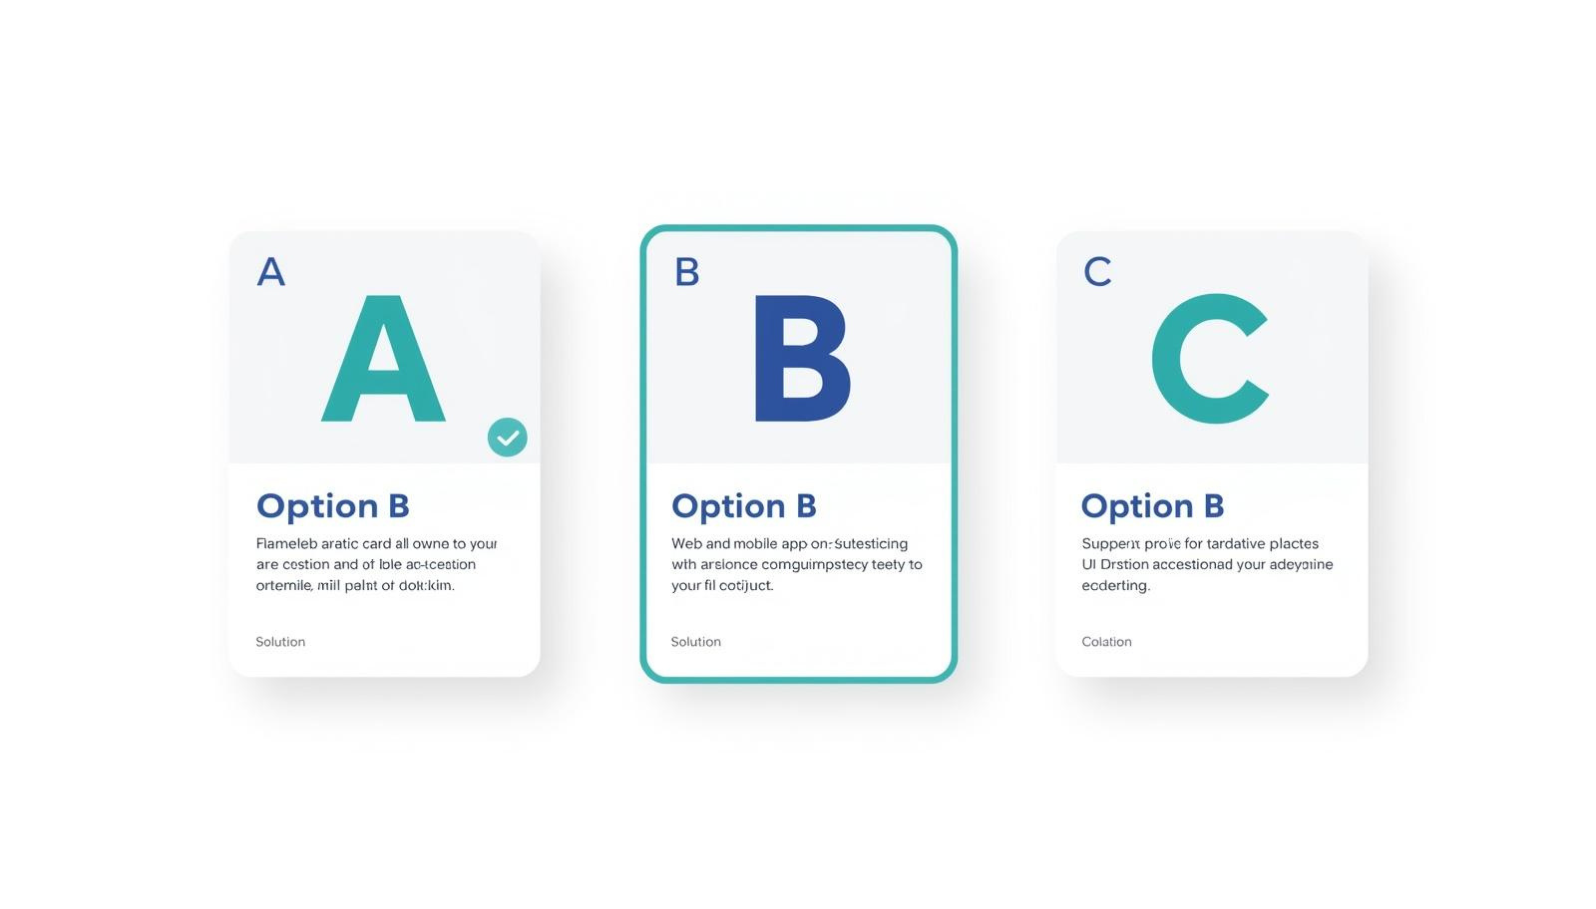
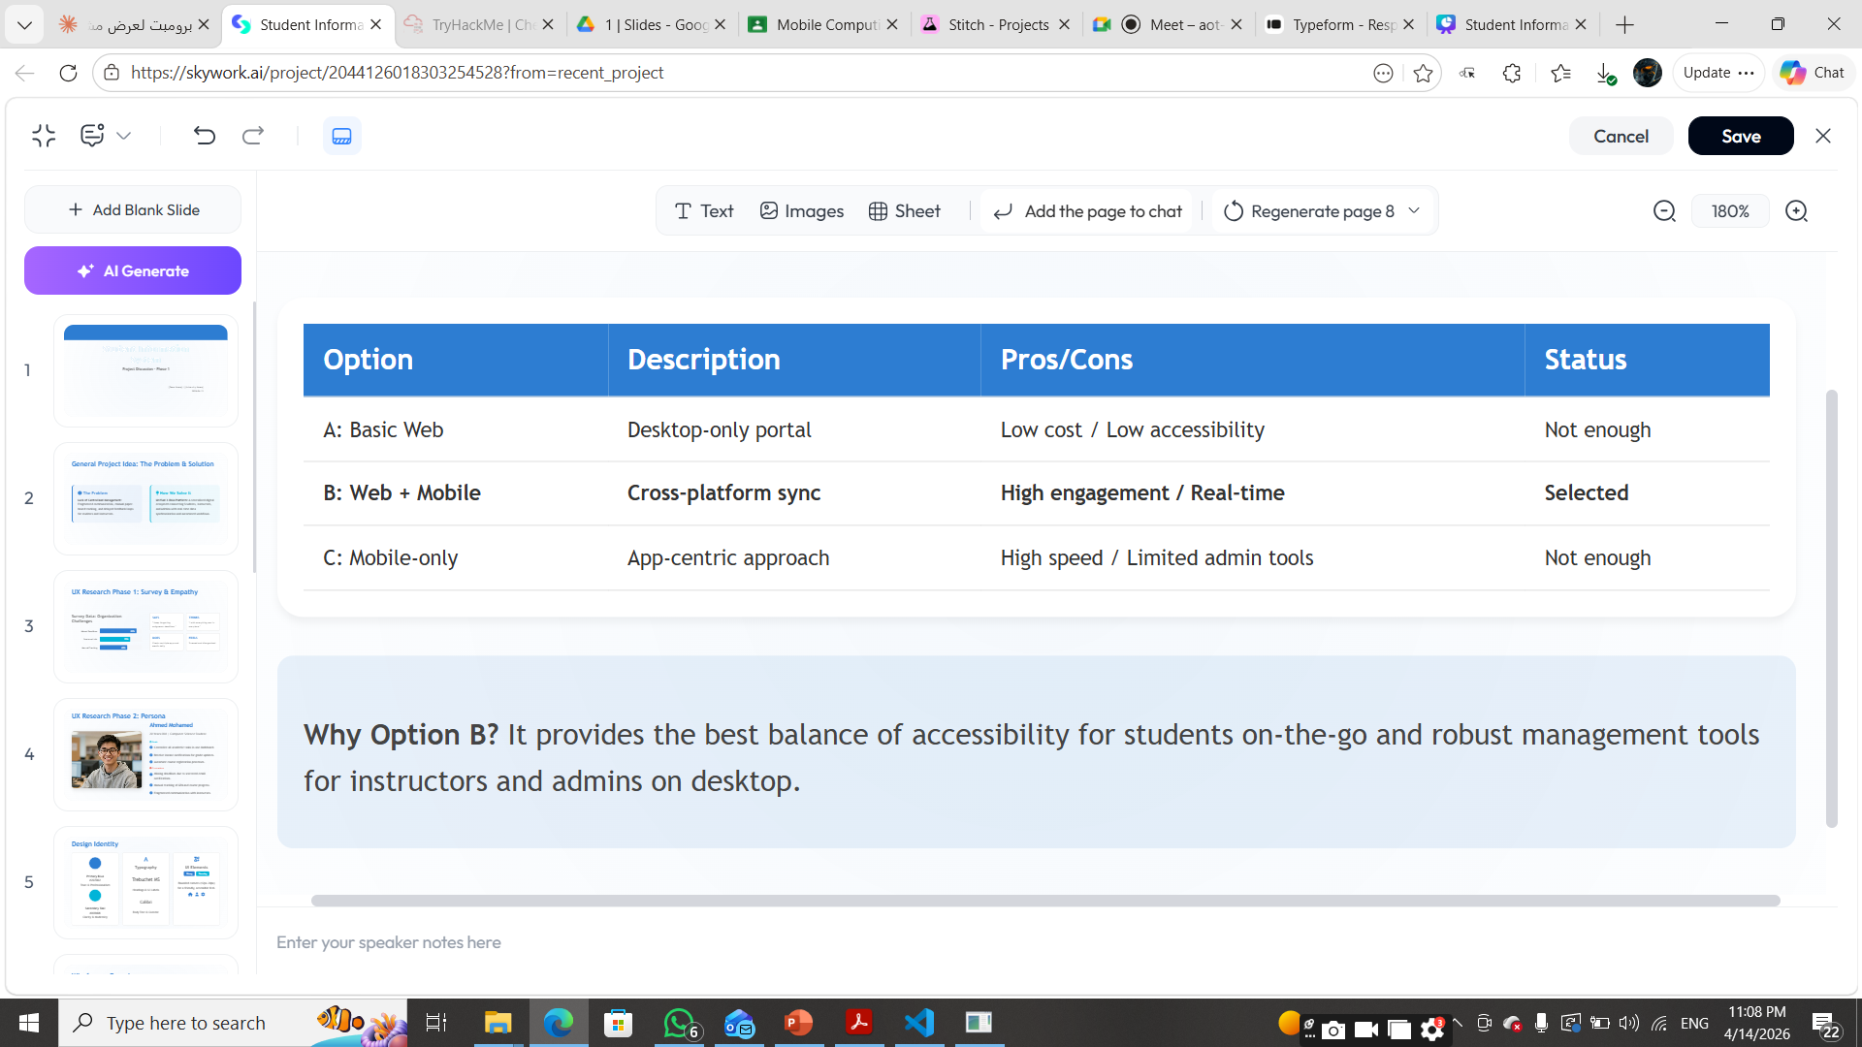
proposed solutions

Slide 5
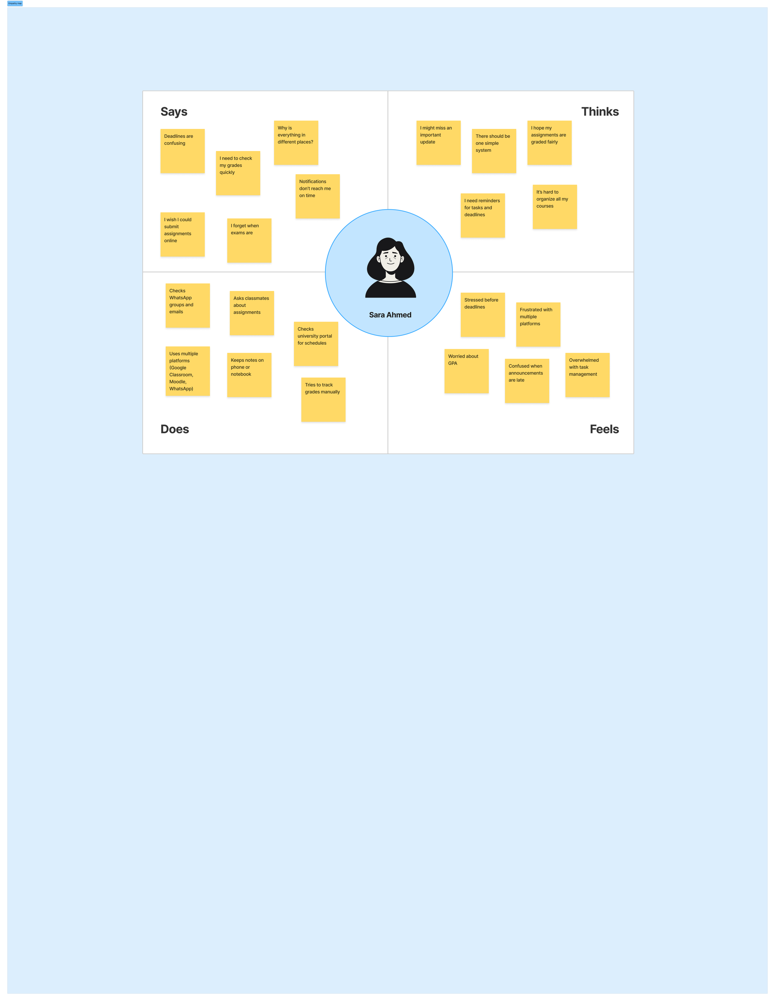

UX Research : Empathy Map
Student

Slide 6
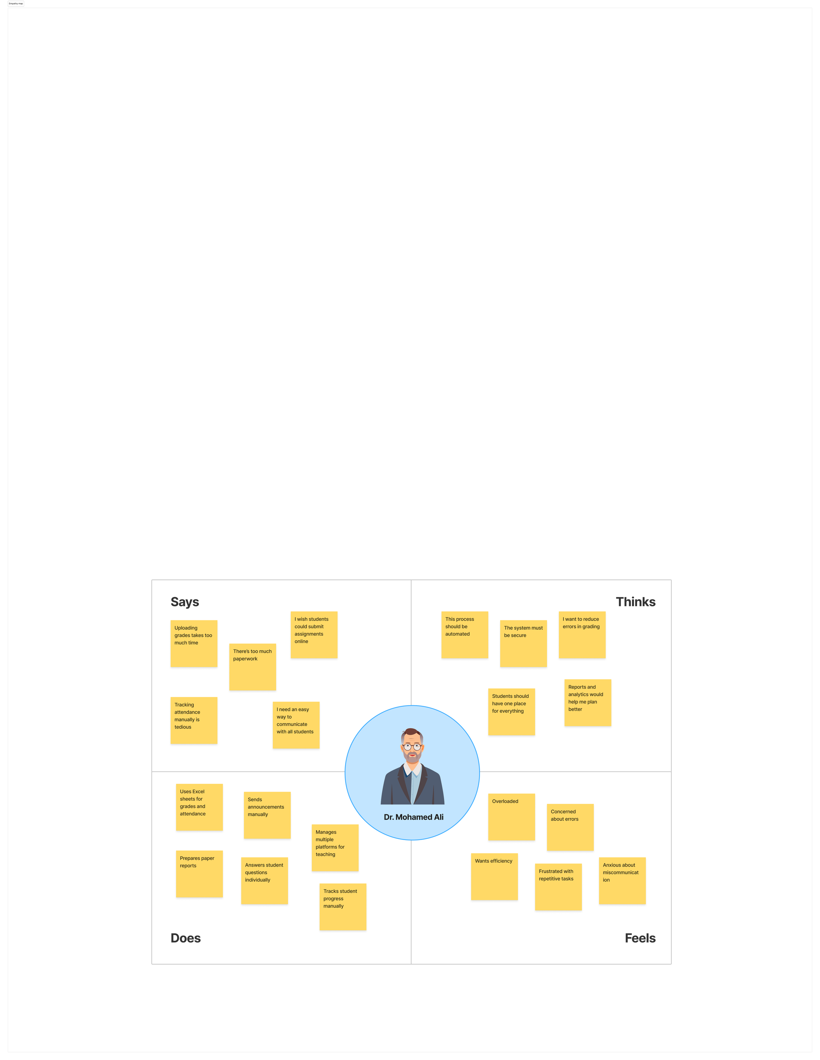
UX Research : Empathy Map
Instructor

Slide 7
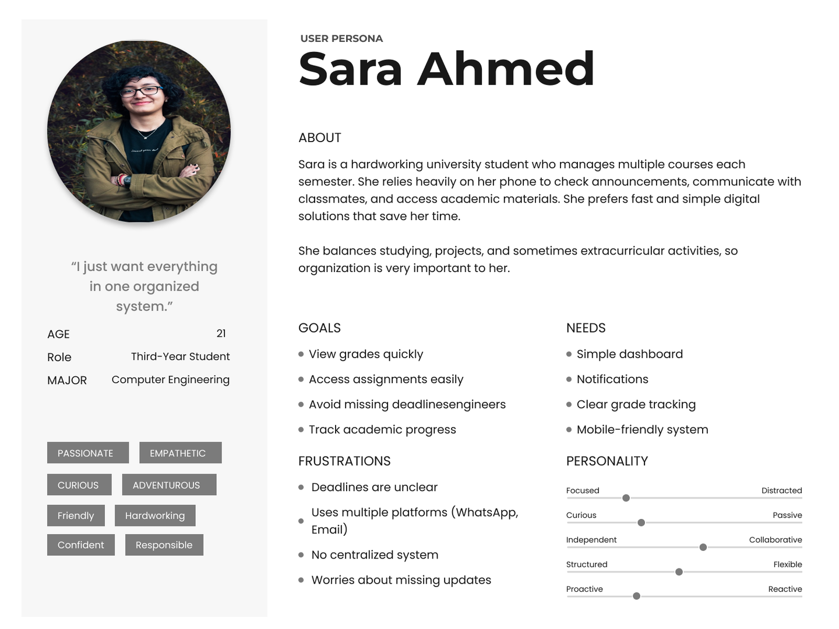
Student Persona
Sara represents a typical student.
She manages multiple courses and needs a simple way to track grades and assignments.
Our system helps her stay organized.

Slide 8
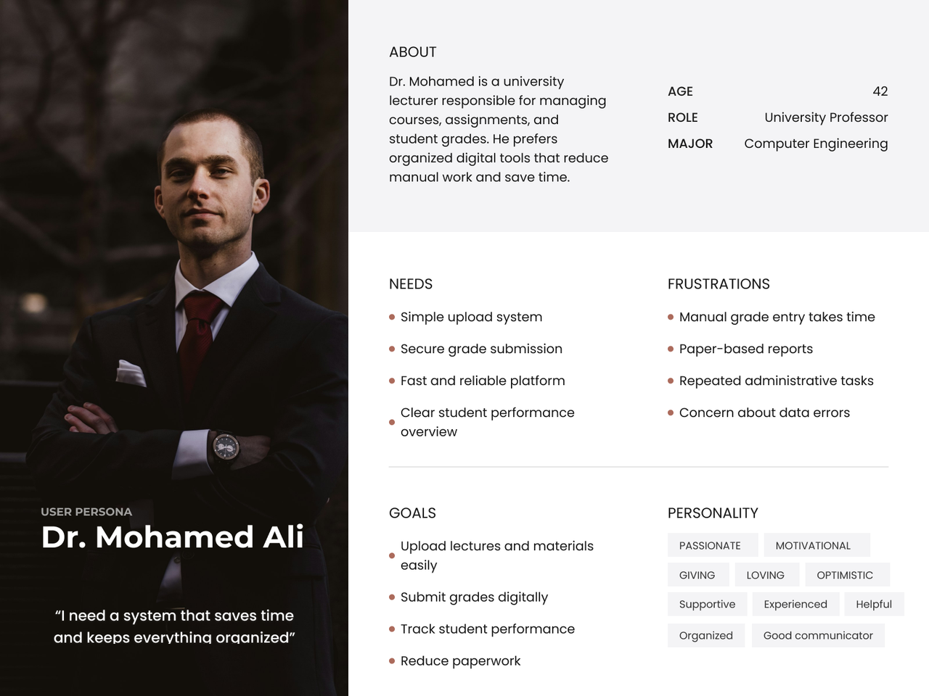
Instructor Persona
This persona represents the instructor.
Dr. Mohamed manages courses, assignments, and grades.
He needs a simple system to upload materials and submit grades.
Our system helps him stay organized and save time.

Slide 9
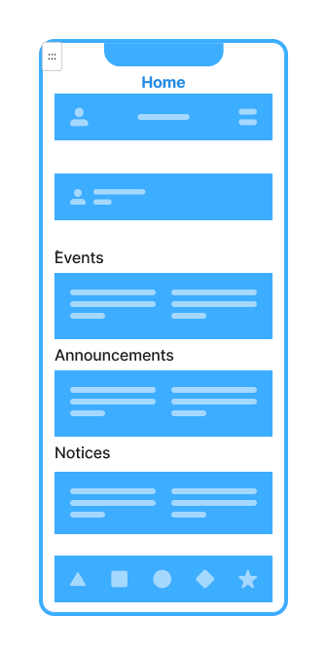
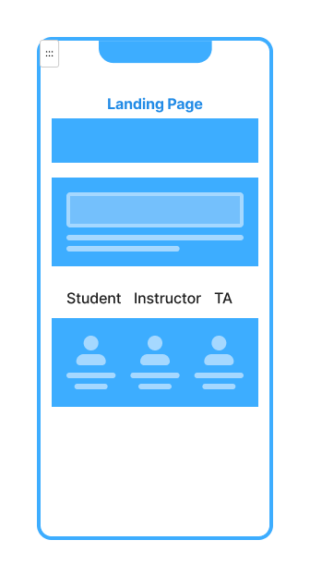
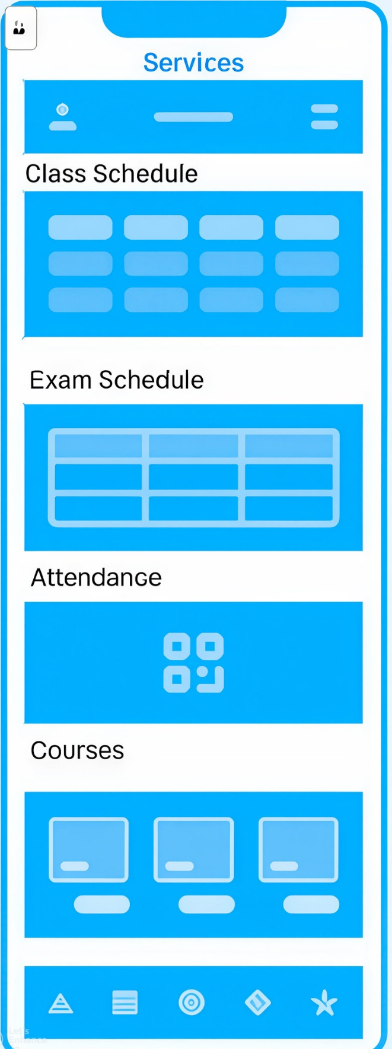
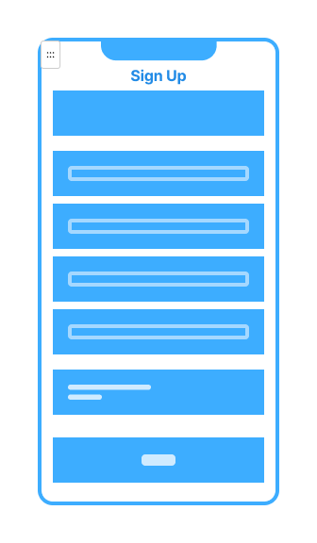
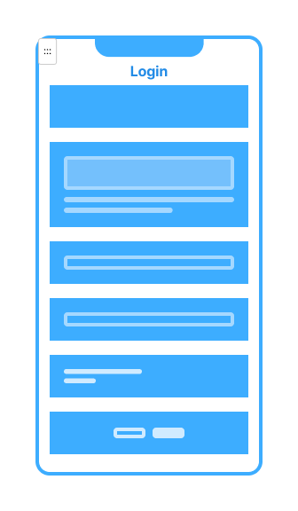
Wireframe Overview

Slide 10
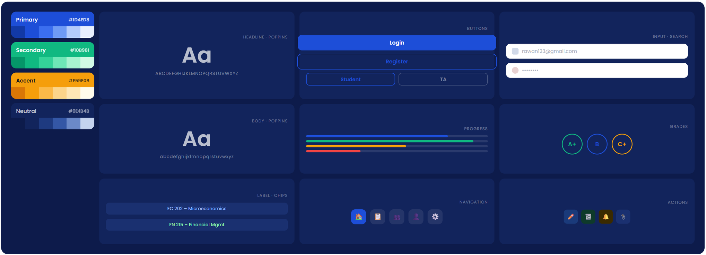
Design System

Slide 11
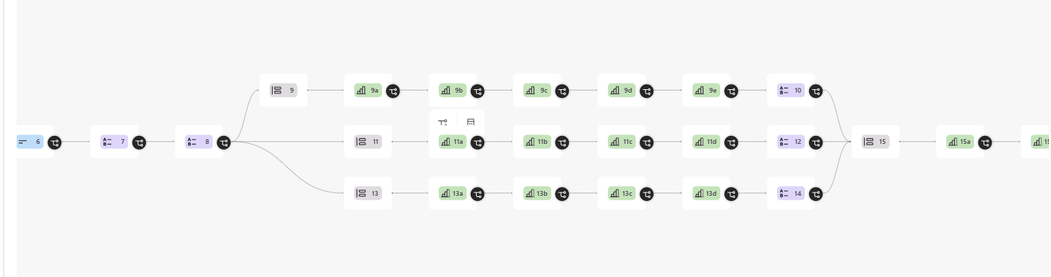
survey Hierarchical workflow
A hierarchy questions workflow each branch is specified for a specific role in the system ( student / instructor / admins ) with a common and specific
Questions according to visitor’s role

Slide 12
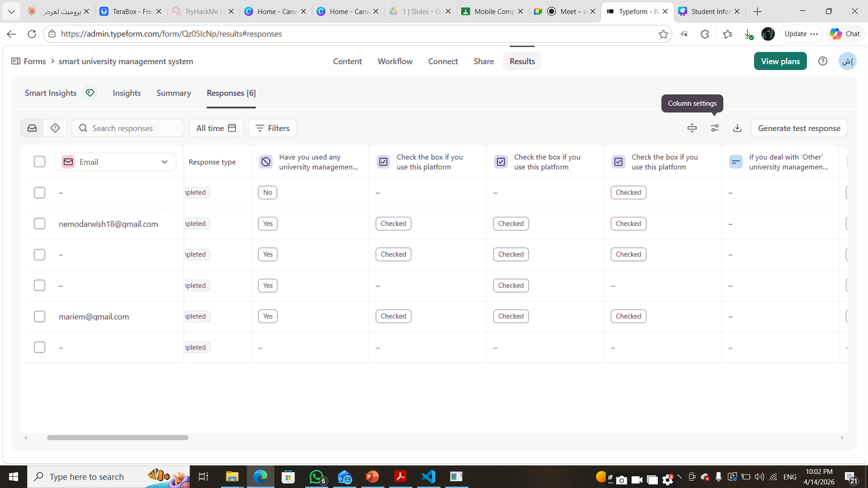
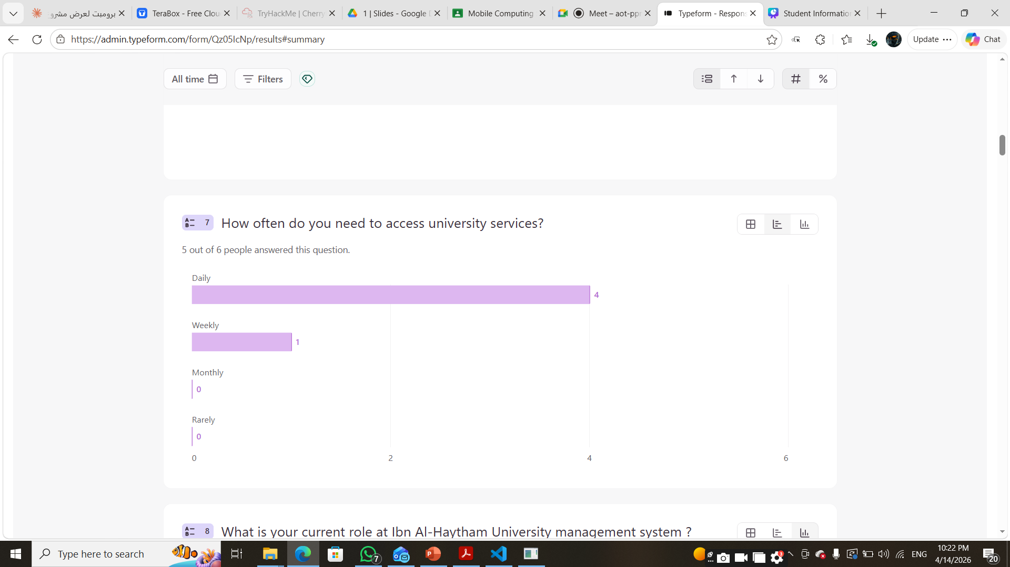
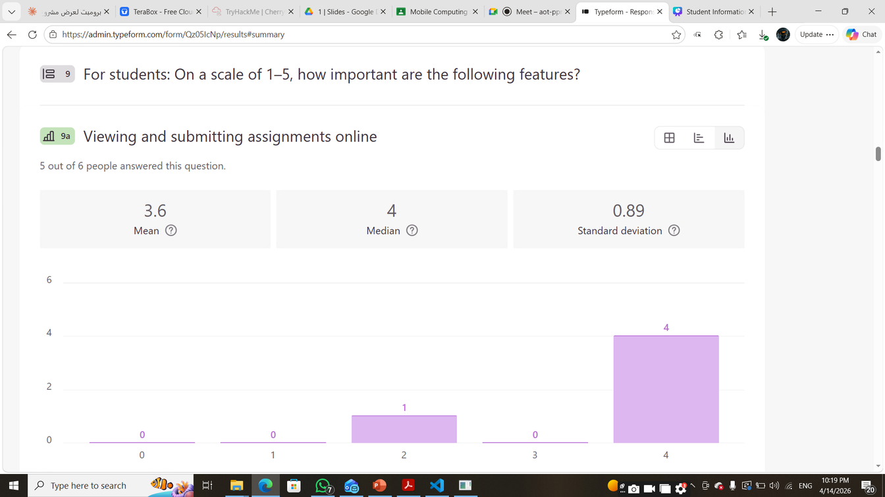
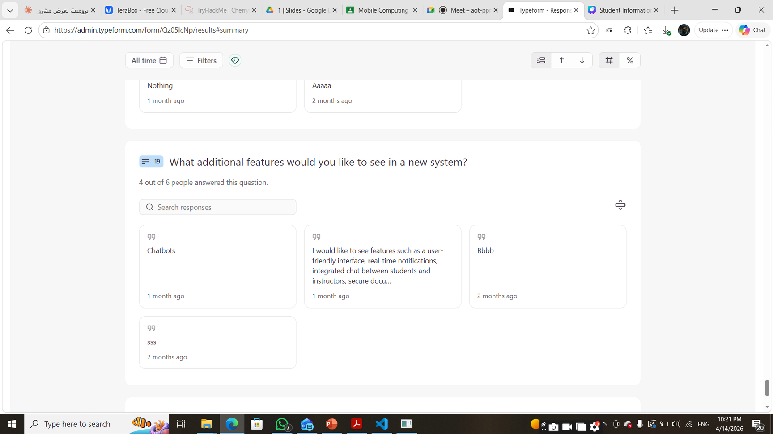
survey results samples

Slide 13
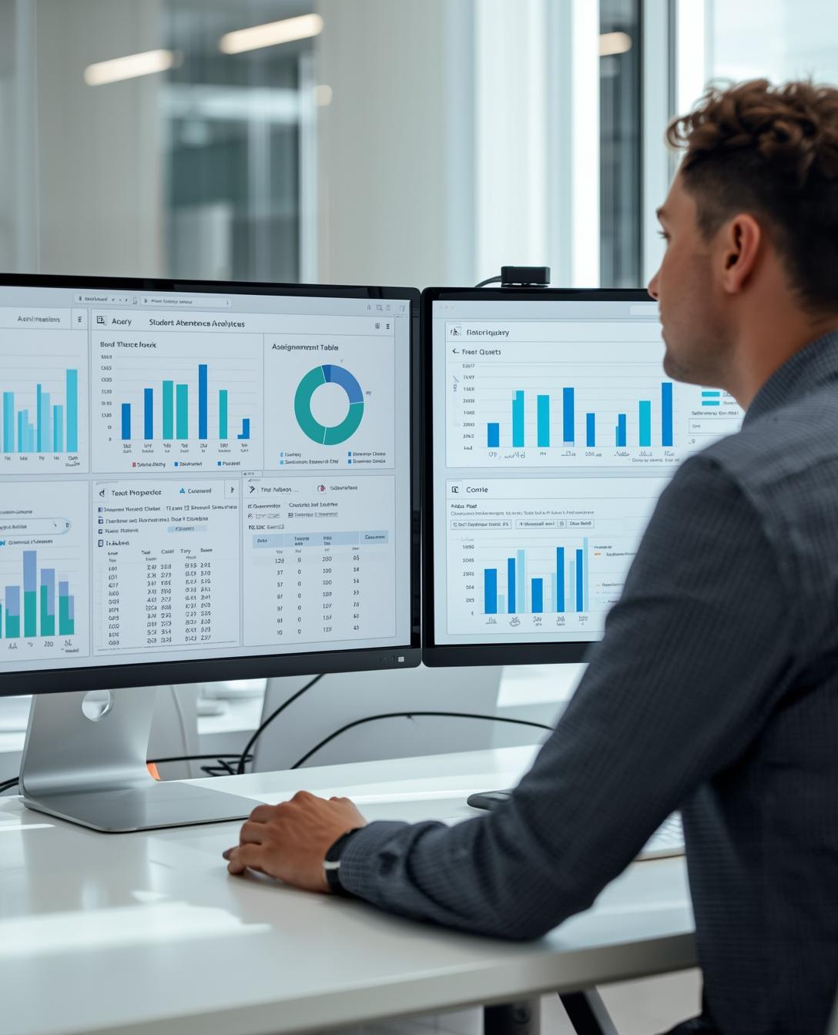
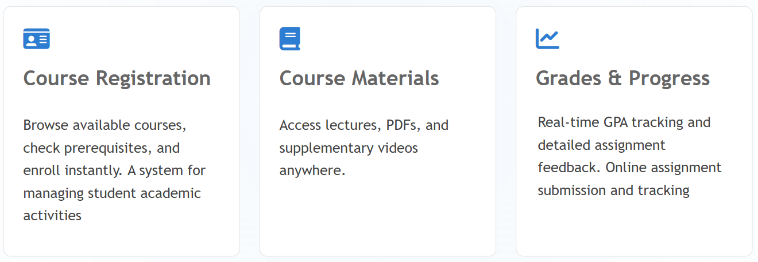
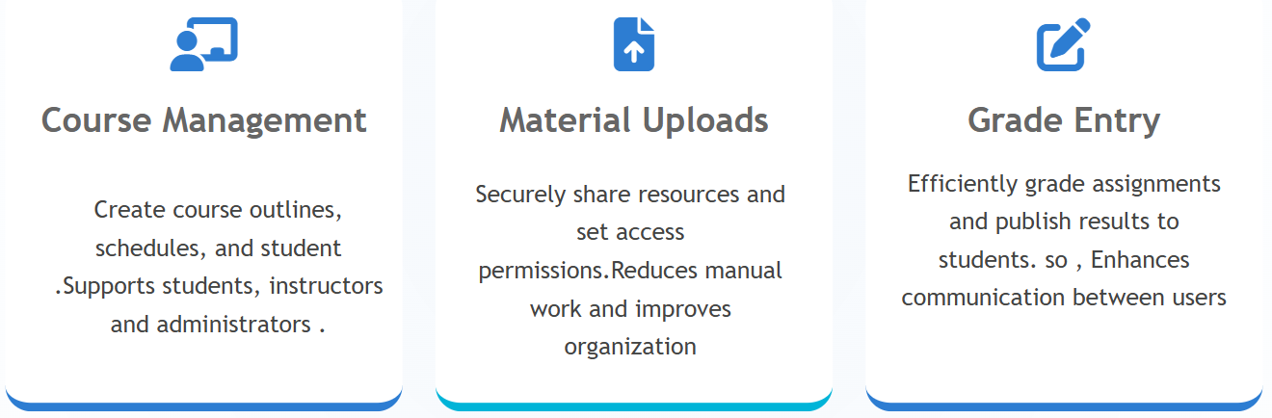
Features Overview

Slide 14
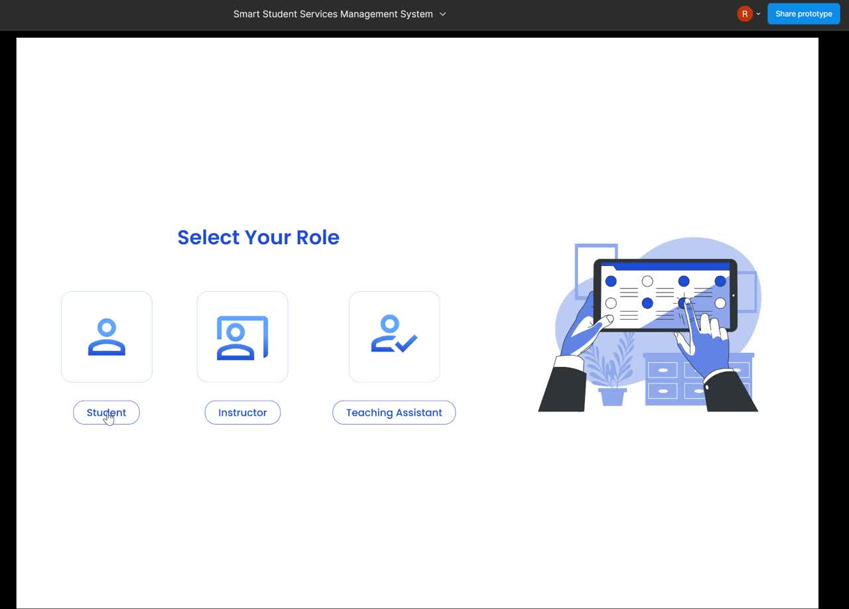
WebSite Demo

Slide 15
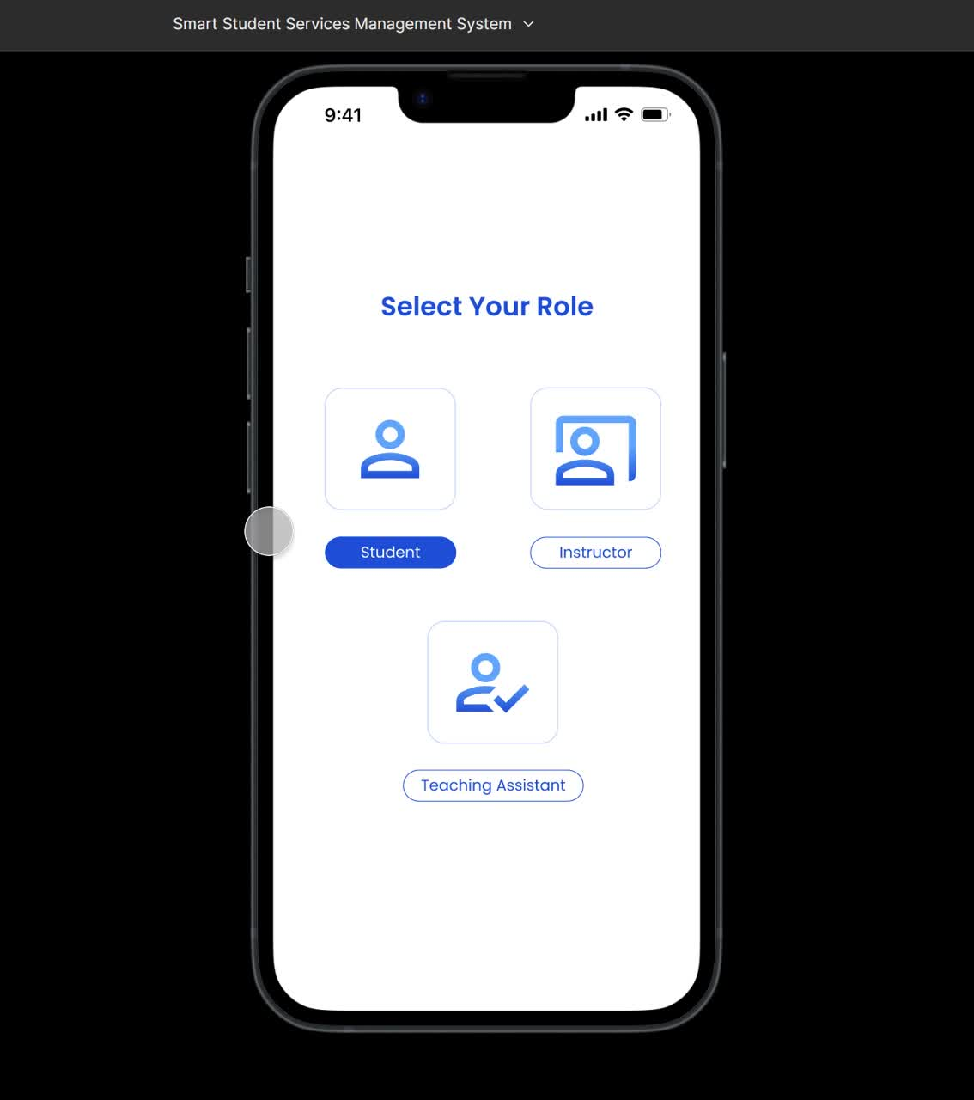
Mobile App Demo

Slide 16

Presented By :
Shahd Ahmed Mahmoud Ewais
Rawan Gamal Abdullah
Mariam Mohamed Mahmoud
Shahd Ahmed Ebrahim
Abdelrahman Samy
Abdelrahman Saad
Thank You!
Questions & Discussion

